Slide 1
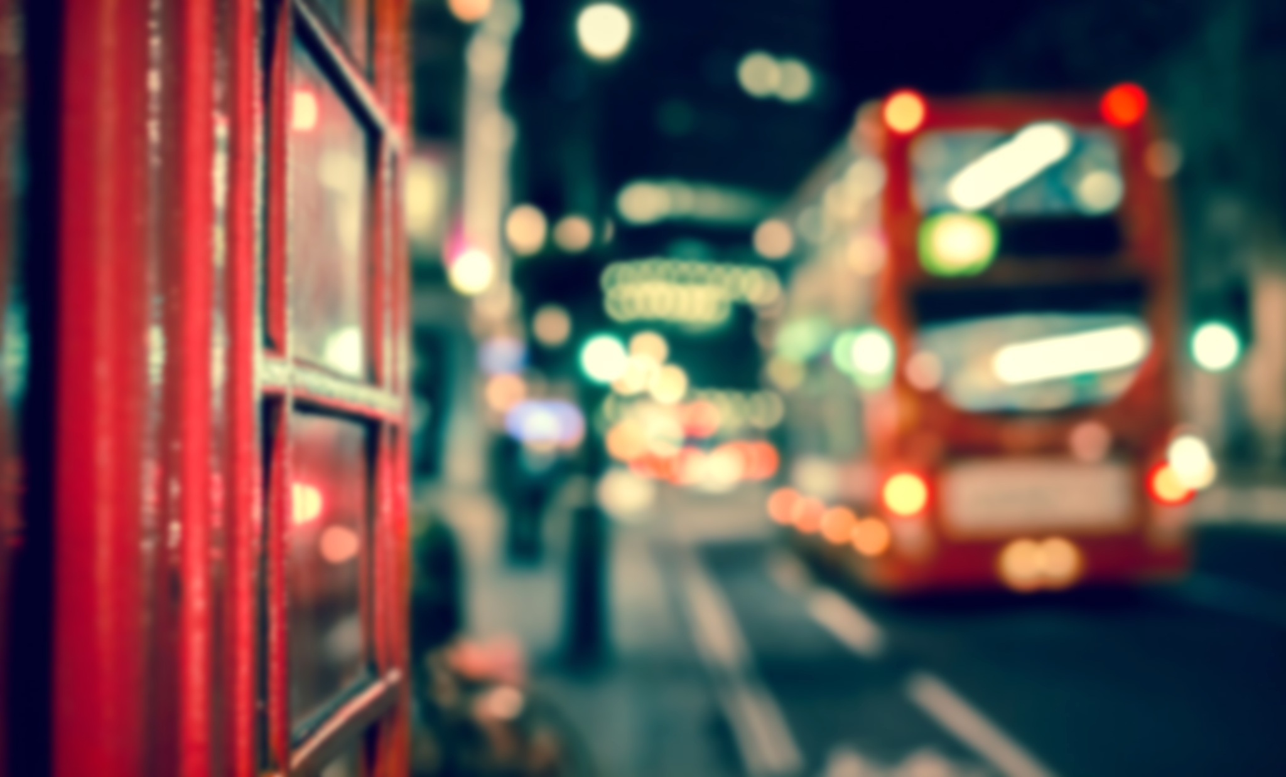
University bus service
Haneen Mohammed
Student at:
University of Mousel, College of Medicine
Under the supervision of
Dr. Hiba and Dr. Maan

Slide 2
Contents
How did it pop up?
Summary
Needs
Goals and benifits

Slide 3
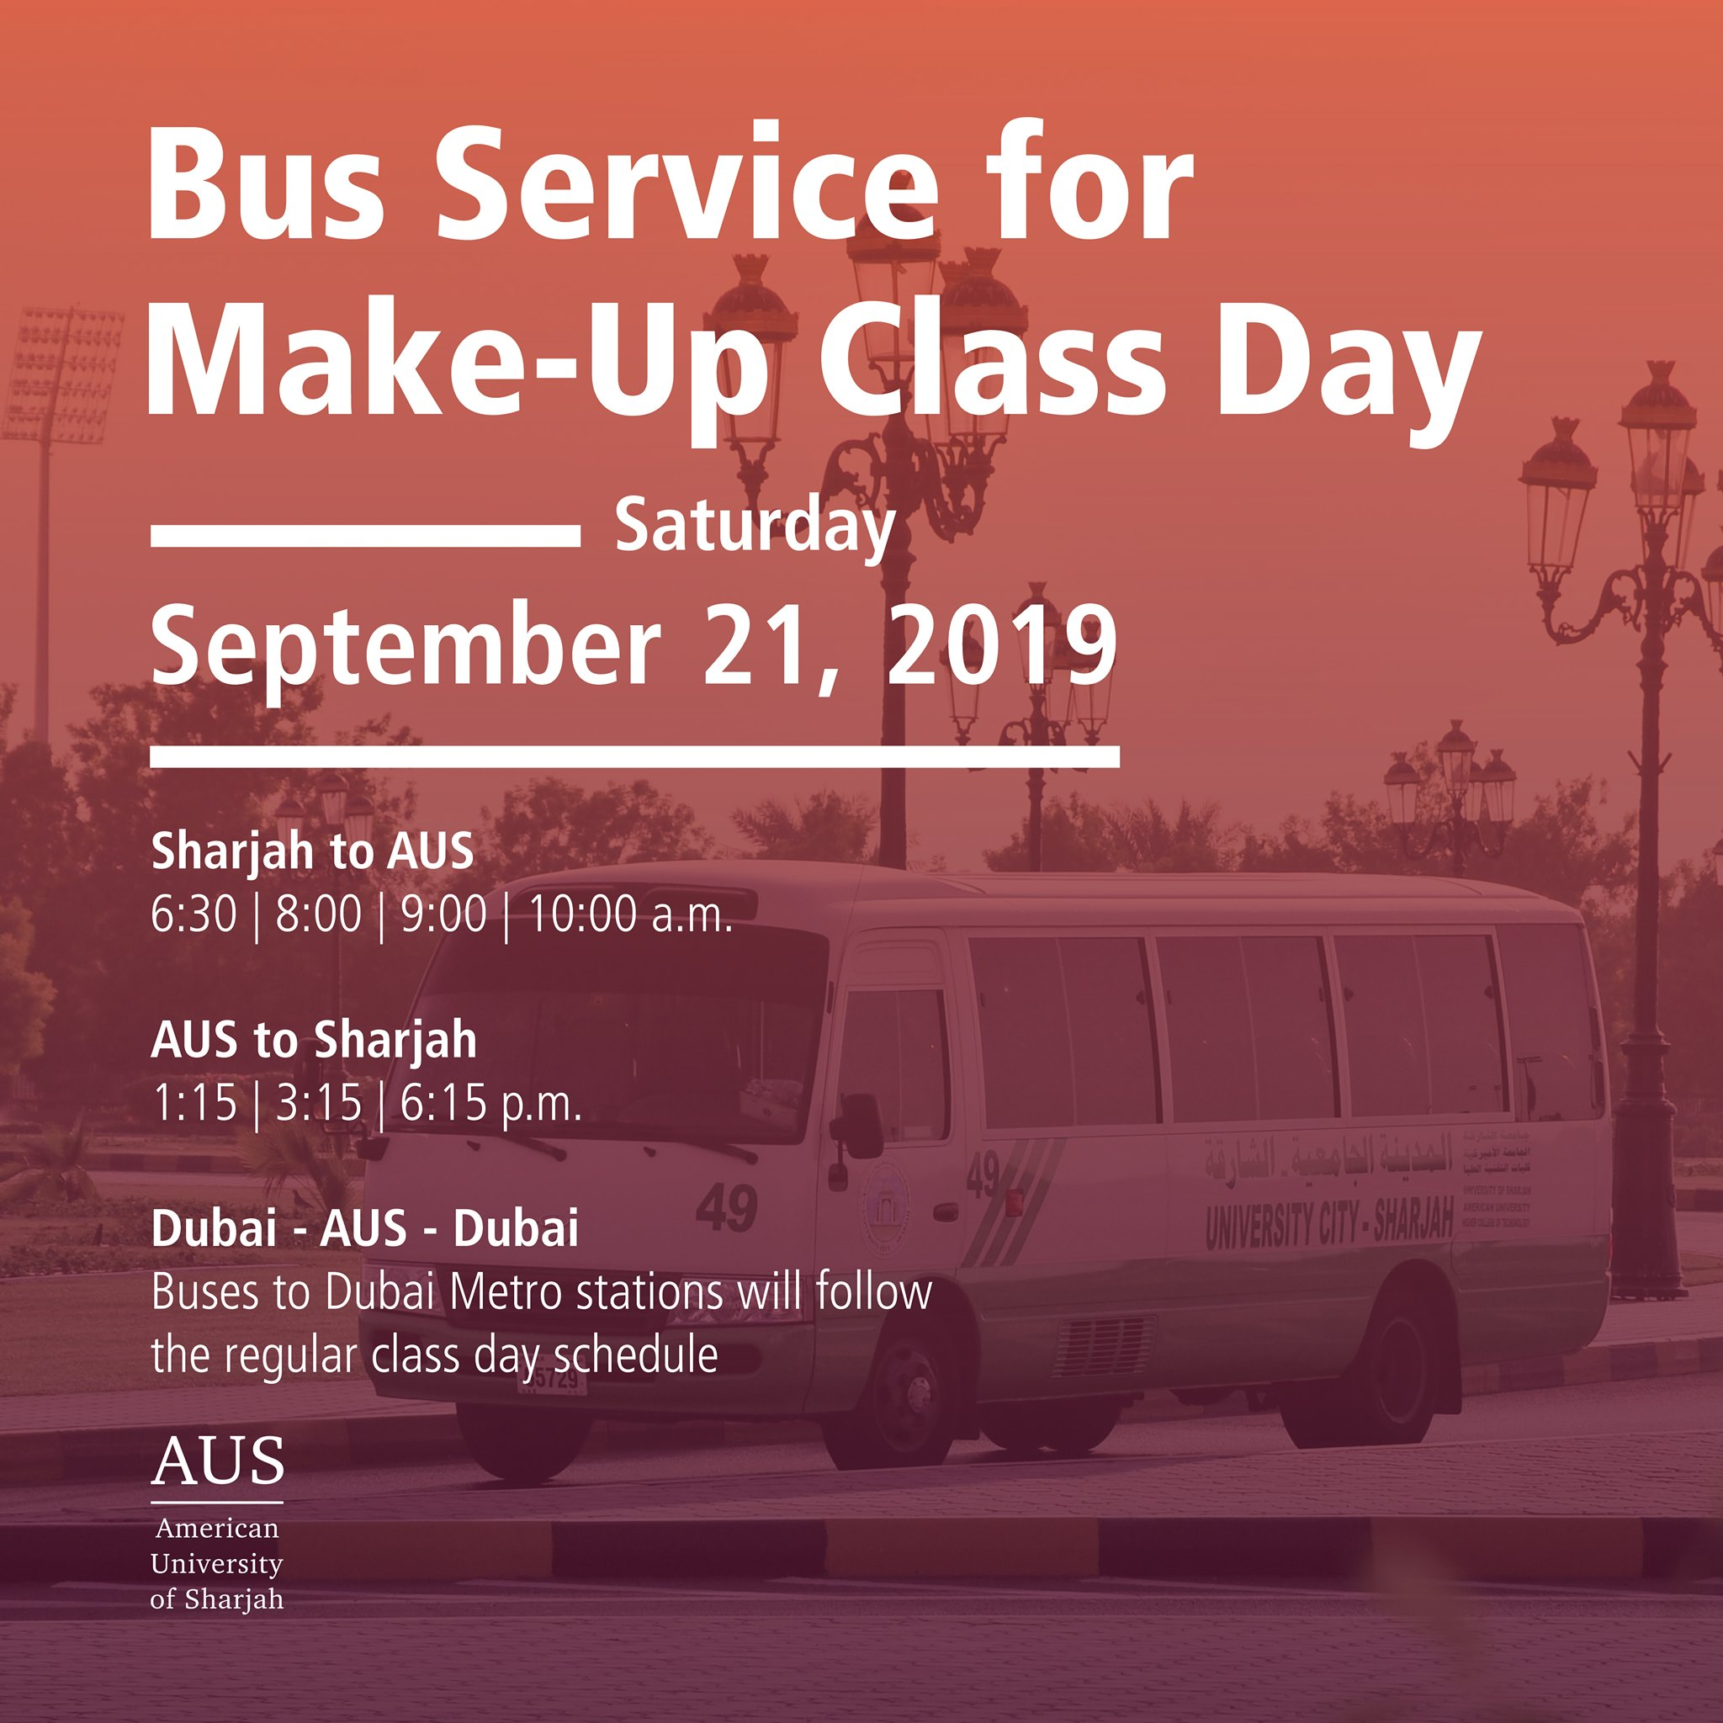
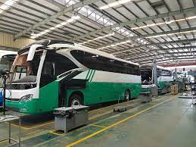
How did it pop up?
UAE, Sharjah, University city

Slide 4
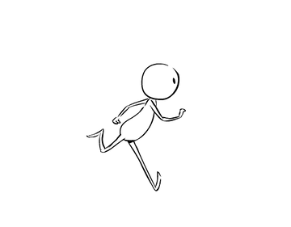
Summary:
The project emphasizes on the challenges university pupils face in finding a fast and safe transportation as they get admitted to their college. It focuses on bus routes at different timings that move students from assembly points which are known landmarks at neighborhoods to the university and the route back for students as soon as they finish their classes and assigned duties.

Slide 5
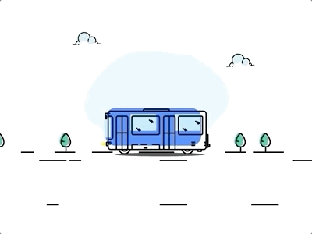
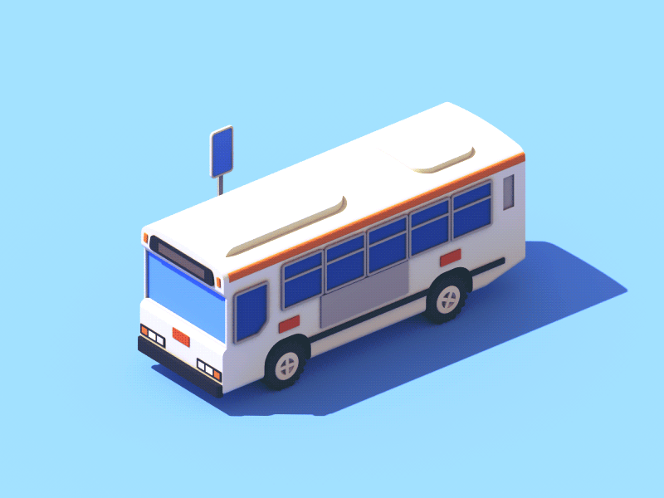
As an example:
Students living at the left cost in Al Muharibeen neighborhood could gather at Thyab Al Iraqi mosque as an assembly point to be picked up at different shifts that buses will be given and then moving to assembly points of neighboring quarters knowing that the same method is applied in the route back from the university. Timings are to be distributed into shifts among buses to ensure time efficiency for candidates to catch up their classes at their specified timings.
Neighborhoods
Timings
Bus routes
Assembly points

Slide 6
Needs :
Buses
Drivers
Commercials
Managers

Slide 7
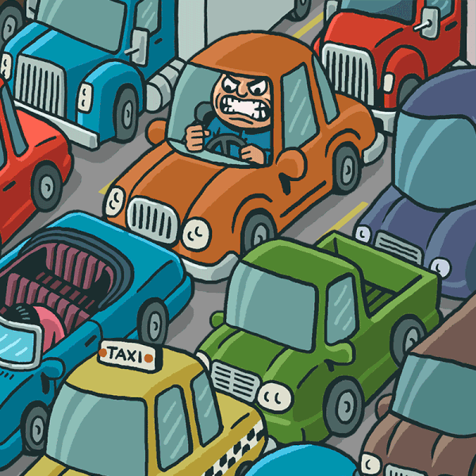
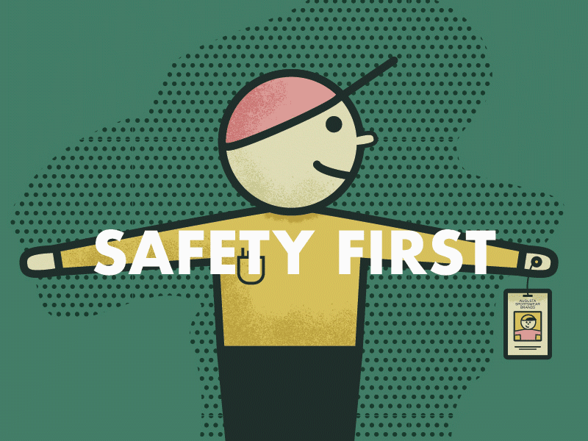
Goals and benifits
It focuses on providing a transportation services for pupils and university facilitators at minimal costs in addition to providing jobs for the unemployed and support investors.
Drivers need to be in full mental, physical and psychological health and are free from any disabilies which could restrict them from their roles. They are said to be taking the full responsibility in ensuring the safety of people on the bus as well as being trust worthy by the families and pupils.
The project fulfils the idea of preventing jammed roads and traffic allowing students and other citizens to reach their duties at time. Usually it is said to be less costly for students as compared to private transportation methods.
Notice: all individuals are said to abide by the rules and to be respectful to anyone and everyone.

Slide 8
But how to make our project possible?

Slide 9
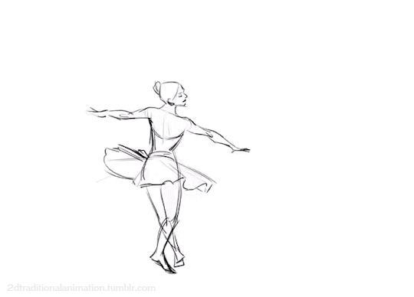
Thank You

