Slide 1
To make the city of Mosul more beautiful, purer and cleaner
Amena nasrat ahmed
University of Mosul/Environmental Sciences and Technologies
ED03
Dr. Maan Dr. Hiba

Slide 2
Aim of Project
By working, we make our city more beautiful. l like to express my thoughts as a student l hope to make my city one of the most beautiful, finest and cleanest environments to live in. l want to contribute to reducing pollution and removing diseases from my environment. As an environmental student, l also loves to monitor and supervise the environment to prevent harm to my family and society. This is to maintain a cleaner environment, and for this reason environmental science was called a science for a better life.

Slide 3
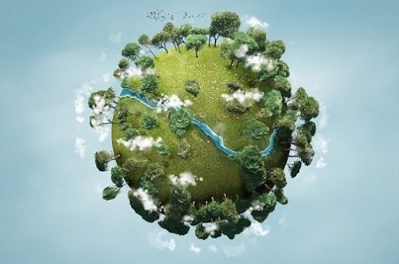
Environmental sciences
The study of environmental sciences includes phenomena full of danger and scientific suspense and will help us understand and improve their protection systems on a large scale locally and globally by enhancing our understanding of the complex environmental systems around us, and their interaction with each other in order to solve the problems that affect their balance and that is to work on improving the management of natural water resources as healthy and balanced as possible.
ln this way we will be able to identify and implement effective solutions to the environmental challenges that we face today and expect them in the future. we have to do something positive and rid my city of the world of destruction, negativity and indifference to the most dangerous elements of life.

Slide 4
Conclusion
The environment is the basis of everything on earth, so at the end of the research on the environment, we must help preserve it and use all possible means that reduce pollution and preserve our beautiful environment.

