Slide 1
Extraction of Polyisobutylene from Internal Tubes Waste of Truck Tires
Idea owner: Mahmood Nashwan
This project aim to use simple and cheap chemical methods into extraction of polyisobutylene elastomer
polyisobutylene elastomer have different uses:
1- In the production of engines oil, bituminous oil, hydraulic, etc.
2- In the production of pressure sensitive stickers and thermal stickers.
3-As sealant in cars and windows.
4-As tear- resistant rubber wrap.
5-As electrical insulator.
Notes:
1

Slide 2
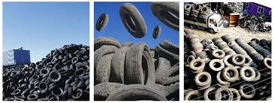
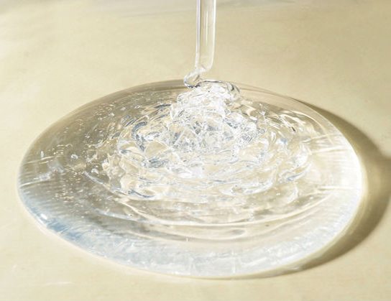
This project would be benefited in save environment from used tires waste, in the same time, would contribute in producing different materials are useful in industry, building and cars repairing. Finally, work in providing job opportunities in polyisobutylene recovery plant.

